Slide 1
Automated Spike Sorting
Xiao Huang
Suhas Lohit
Rakshit Raghavan

Slide 2
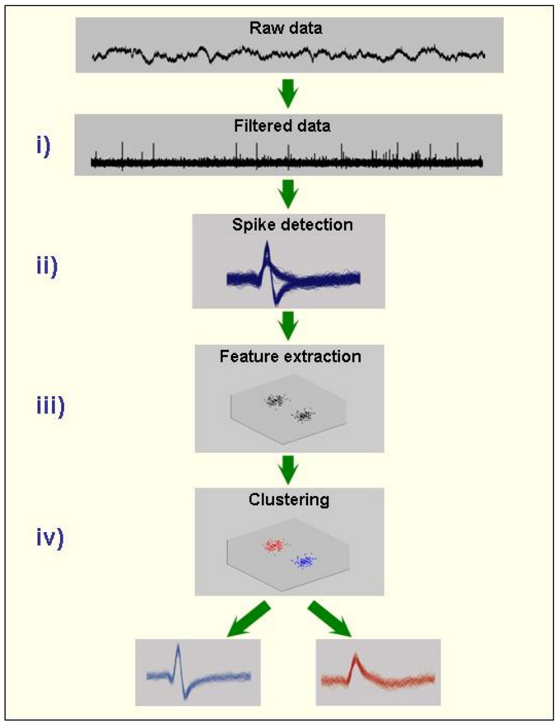
Automated Spike Sorting
“Spike sorting is the grouping of spikes into clusters based on the similarity of their shapes...The end result of spike sorting is the determination of which spike corresponds to which of these neurons.”[1]
Steps involved:
Filtering
Spike Detection
Feature Extraction
Clustering

Slide 3
Feature Extraction Methods
Principal Component Analysis (PCA)
Haar Wavelet Features
Shape Context Features
Clustering Methods
K-means
Gaussian Mixture Models (GMM)
Self Organizing Maps (SOM)
Density Based Spatial Clustering of Applications with Noise (DBSCAN)

Slide 4
Feature Extraction Methods
Principal Component Analysis (PCA)
Haar Wavelet Features
Shape Context Features
Clustering Methods
K-means
Gaussian Mixture Models (GMM)
Self Organizing Maps (SOM)
Density Based Spatial Clustering of Applications with Noise (DBSCAN)

Slide 5
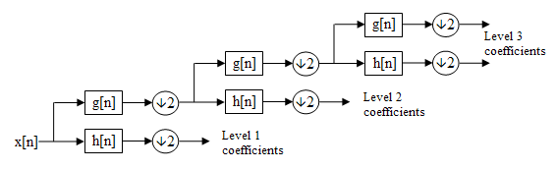
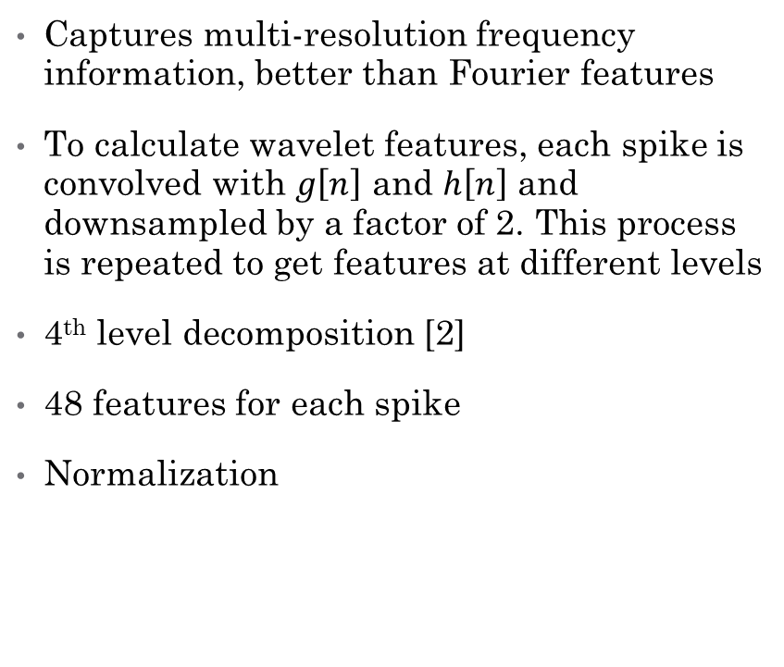
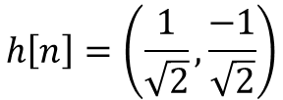
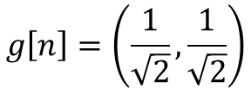
Haar Wavelet Features
Captures multi-resolution frequency information, better than Fourier features
To calculate wavelet features, each spike is convolved with $g\left[n\right]$ and $h\left[n\right]$ and downsampled by a factor of 2. This process is repeated to get features at different levels
4th level decomposition [2]
48 features for each spike
Normalization
$$g\left[n\right]=\left(\frac{1}{\sqrt{2}},\frac{1}{\sqrt{2}}\right)$$
$$h\left[n\right]=\left(\frac{1}{\sqrt{2}},\frac{−1}{\sqrt{2}}\right)$$

Slide 6
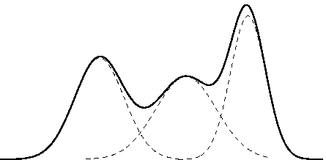
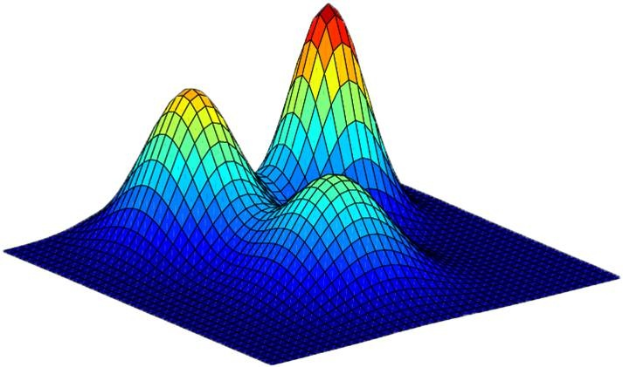
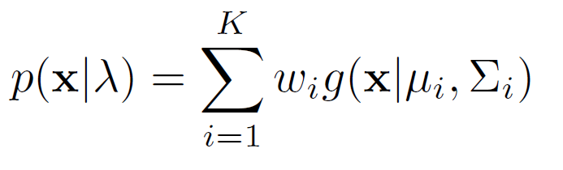

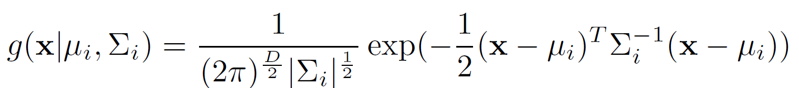
Gaussian Mixture Models (GMMs)
Data are assumed to be distributed as a mixture of Gaussians
Spike clusters are represented by the K Gaussians
Problem reduces to learning the parameters of the GMM
D = 1
D = 2

Slide 7
Gaussian Mixture Models (GMMs)
Parameters are learnt using the Expectation – Maximization (EM) algorithm
EM for GMM:
Initialize the parameters
Loop until convergence:
Expectation : Compute cluster membership probabilities
Maximization: Update parameters using the probabilities
Can be seen as a soft version of K-means
The problem is non-convex, unbounded and multi-modal
EM is only a heuristic and can get stuck in local optima
Initialization is an issue. We use the best k-means solution over multiple runs to determine the initial parameters

Slide 8
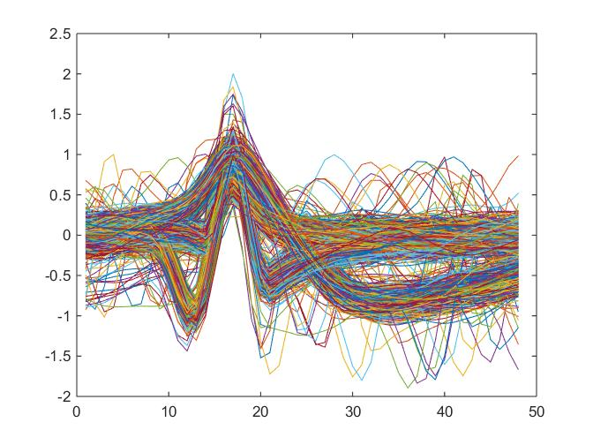
GMMs and Outliers
In the maximization step of EM, the updates are weighted by the probabilities of the datapoints
Outliers are likely to be assigned low probabilities. Hence GMMs are less sensitive to outliers. This is the reason why GMMs are superior to K-means
This makes GMMs a good choice for spike sorting
Possible outliers

Slide 9
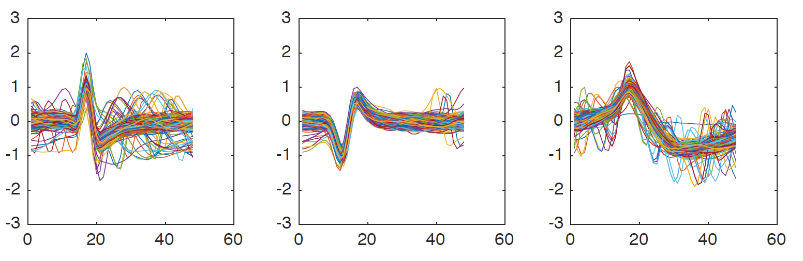
Experimental Results
Dataset 1 – 96.20%

Slide 10
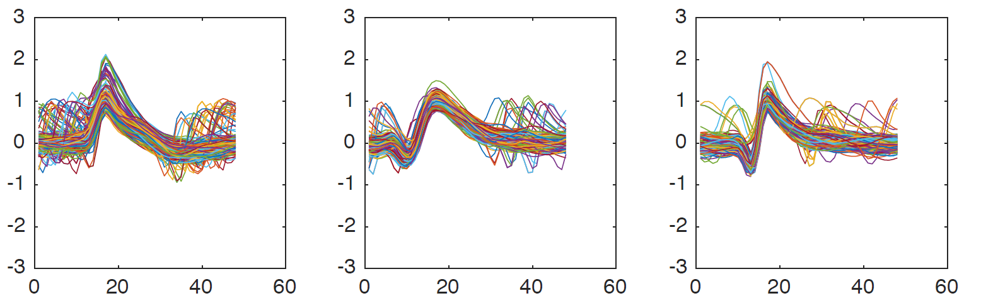
Experimental Results
Dataset 2 – 94.13%

Slide 11
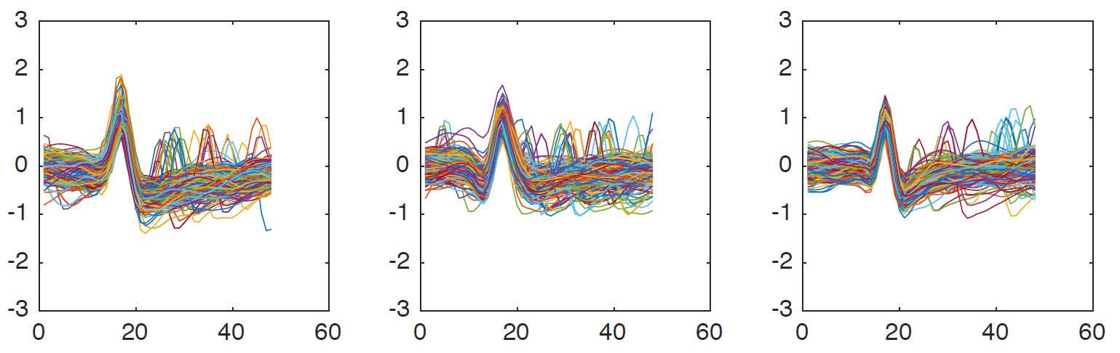
Experimental Results
Dataset 3 – 94.60%

Slide 12
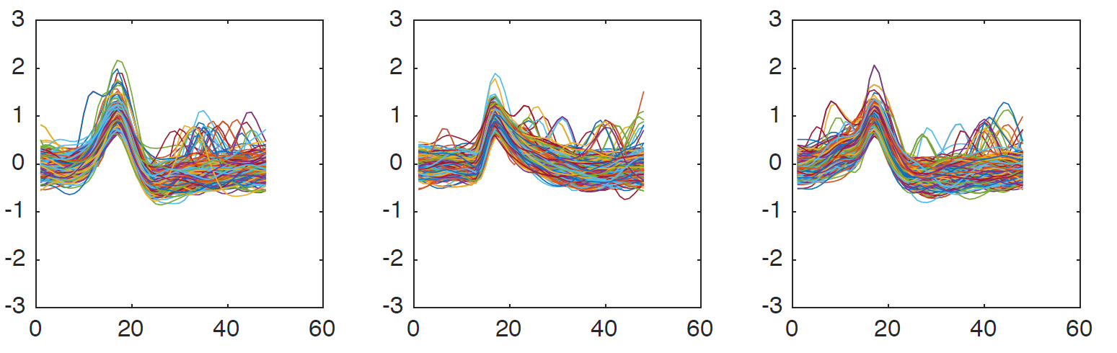
Experimental Results
Dataset 4 – 94.33%

Slide 13
Time Complexity (in seconds)
Method | Initialization | Dataset 1 | Dataset 2 | Dataset 3 | Dataset 4
GMM | K-means | 2.05 | 2.26 | 2.07 | 2.55
GMM | Random | 2.29 | 2.87 | 2.77 | 2.87
K-means | Random | 0.009 | 0.011 | 0.011 | 0.016
All values are averaged over 5 runs and run on a 2.7 GHz i7 processor on Matlab
GMM with K-means initialization leads to faster convergence

Slide 14
Conclusion and future work
We have demonstrated that the combination of Haar wavelet features with Gaussian mixture models is very useful for spike sorting
We have obtained good clustering results on all the datasets provided
We plan to investigate the possibility of determining the number of clusters automatically e.g. using Bayesian Information Criterion.
In case of very large datasets, feature selection may be employed to speed up clustering

Slide 15
References
[1] Quiroga R. Quian, Spike Sorting, Scholarpedia
[2] Quiroga, R. Quian, Zoltan Nadasdy, and Yoram Ben-Shaul. "Unsupervised spike detection and sorting with wavelets and superparamagnetic clustering." Neural computation 16.8 (2004): 1661-1687.
[3] Belongie, Serge, Jitendra Malik, and Jan Puzicha. "Shape matching and object recognition using shape contexts." Pattern Analysis and Machine Intelligence, IEEE Transactions on 24.4 (2002): 509-522.

Slide 16
Thank you

Slide 17
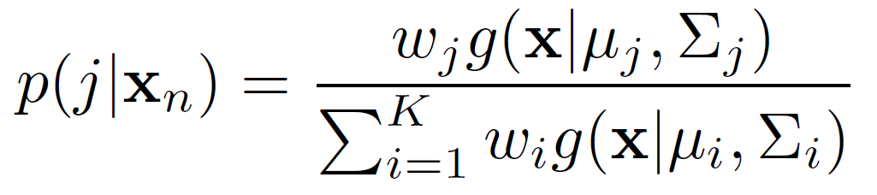
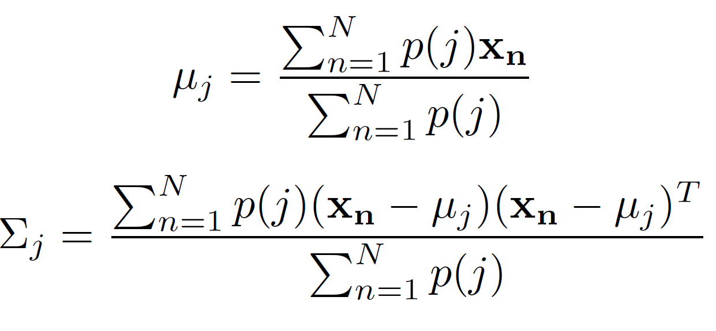
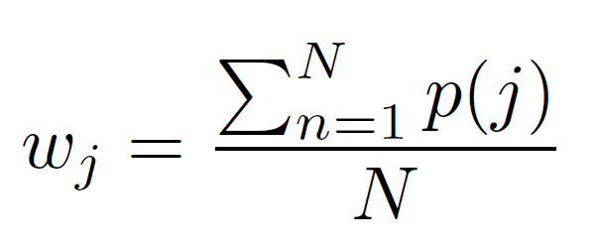
EM details
Expectation:
Maximization:

Slide 18
Shape Context Features
Inspired by computer vision, used in shape matching and hand-written digit recognition [3] – non-linear feature
Transform each spike waveform into an image
For each point that belongs to the waveform, form a histogram of distances to all other points. Concatenate all the histograms to form the final feature vector
Did not yield the best results

